Slide 1
Mini Project 2:
Fraud Detection
Presenter: Shao Ming

Slide 2
Content
Problem Background
Exploratory Data Analysis
ML Model and sampling methods
Parameter tuning
Conclusion
Future Work

Slide 3
Problem Explained
From the moment the e-commerce payment systems came to existence, there have always been people who will find new ways to access someone’s finances illegally.
This has become a major problem in the modern era, as all transactions can easily be completed online by only entering your credit card information.
Even in the 2010s, many American retail website users were the victims of online transaction fraud right before two-step verification was used for shopping online. Organizations, consumers, banks, and merchants are put at risk when a data breach leads to monetary theft and ultimately the loss of customers’ loyalty along with the company’s reputation.

Slide 4
Business Problem
The Bank wants to prevent fraud transactions from occurring. Early detection is required to ensure that the wrong transaction will not happen.
Fraud must be detected when online payment is made.
Find a suitable classification model to predict fraud transaction based on given information of the online payment.

Slide 5
Stakeholders
International Bank for Reconstruction and Development (IBRD)
E-commerce companies

Slide 6

Data Exploration and Analysis

Slide 7
Dataset
Variables
  V1, V2, … V28 : principal components obtained with PCA, transformed from features that are confidential
  Time: Seconds elapsed between each transaction and the first transaction in the dataset
  Amount: transaction amount for each transaction
Total of 284,807 entries
Data source: https://www.kaggle.com/mlg-ulb/creditcardfraud?select=creditcard.csv

Slide 8
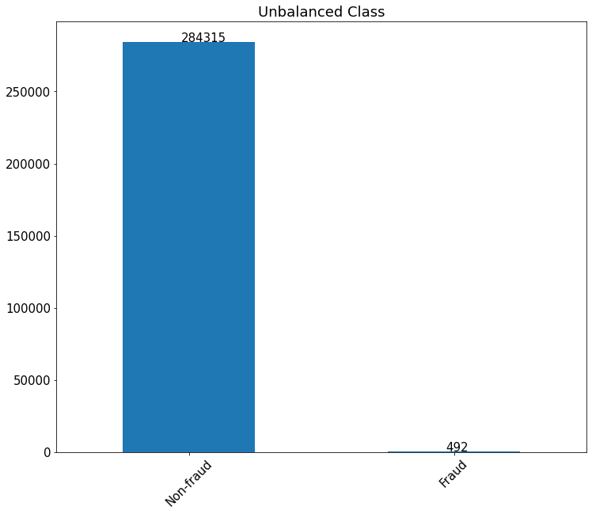
Imbalance Classes

Slide 9
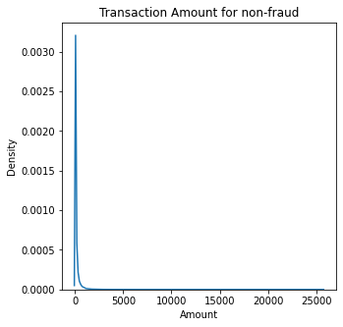
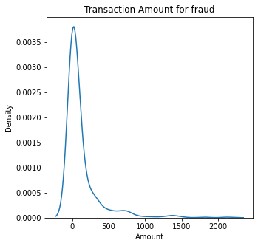
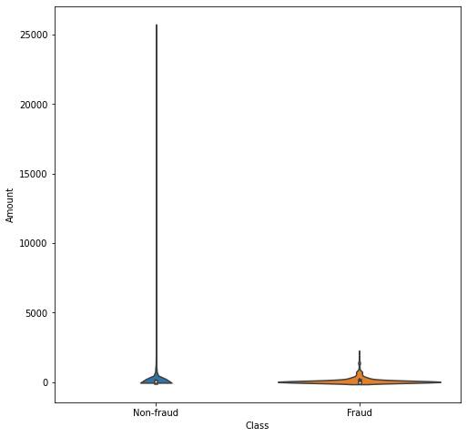
Fraud transaction amount tend to be smaller

Slide 10
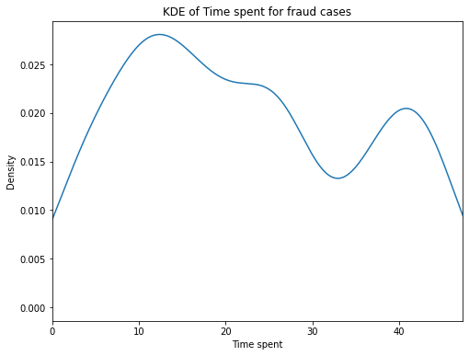
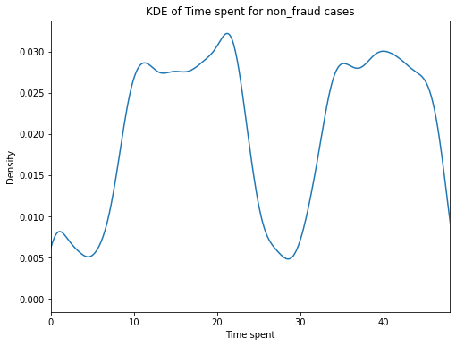
Time spent for both cases

Slide 11
Classification Model used
Logistic Regression
Naïve Bayes
Decision Tree

Slide 12
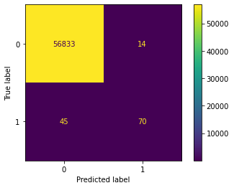
Original Sample
Accuracy = 99.99%!!!!
70
Precision = = 0.83
Logistic Regression
70
14
False Alarm!
70
Recall = = 0.61
70
45
Fraud transaction undetected!

Slide 13
Original Sample
Logistic Regression
Scoring Metrics:
Accuracy = 0.99896
Precision = 0.83
Recall = 0.61
f1-score = 0.7

Slide 14
How to due with imbalance dataset?
Up sampling of minority class
Down sampling of majority class
Synthetic Minority Oversampling Technique, SMOTE

Slide 15
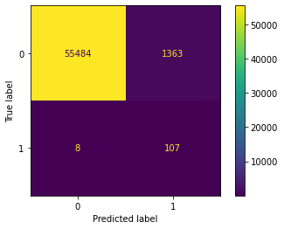
Up sampling used on fraud class
Bootstrap sampling with replacement for fraud data
Scoring Metrics:
Accuracy = 0.9759
Precision = 0.07 (low!)
Recall = 0.93 (improved!)
f1-score = 0.14
Logistic Regression

Slide 16
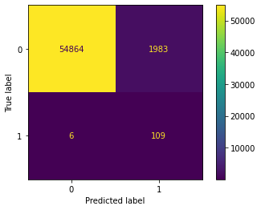
Down sampling used on non-fraud class
Take sample from the original dataset without replacement
Logistic Regression
Scoring Metrics:
Accuracy = 0.96508
Precision = 0.05210 (low!)
Recall = 0.94783 (improved!)
f1-score = 0.09878

Slide 17
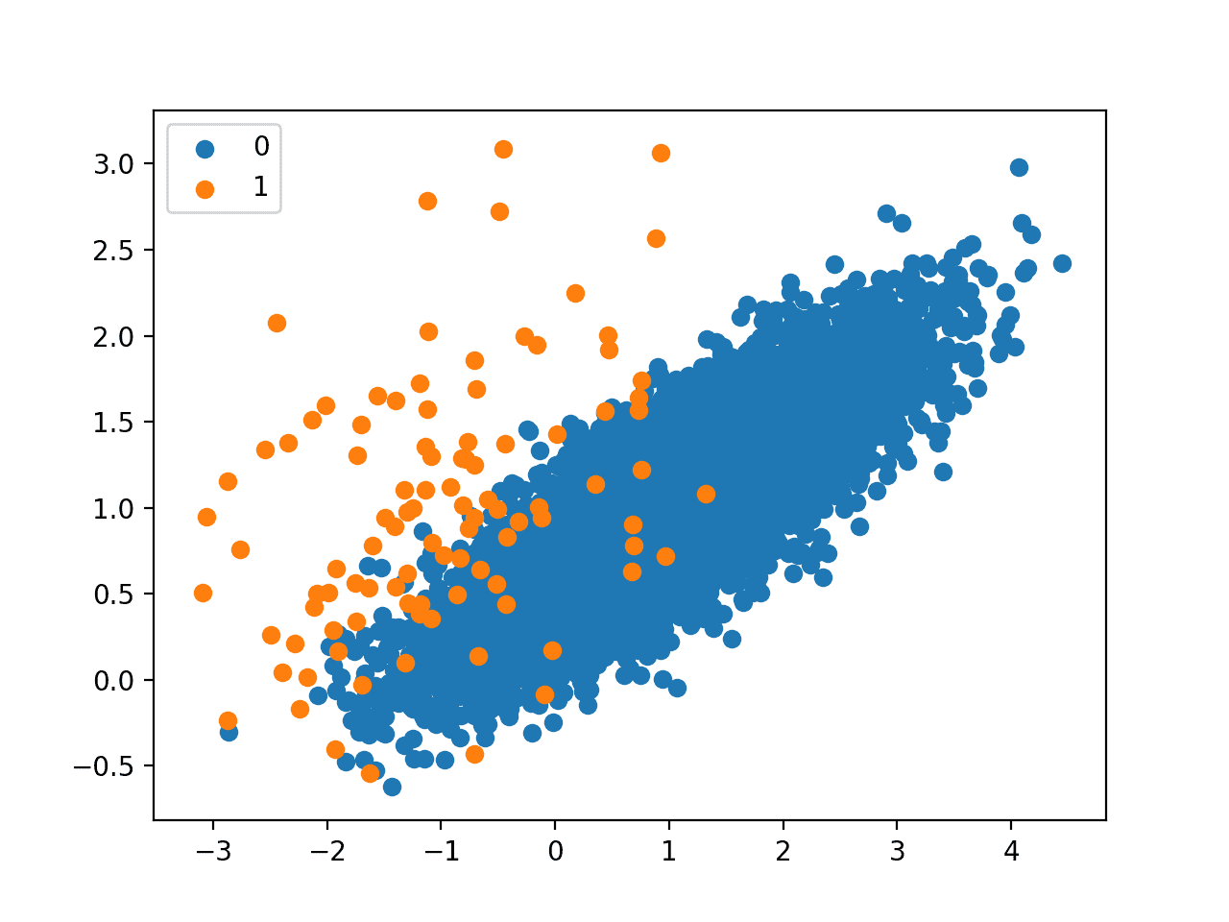
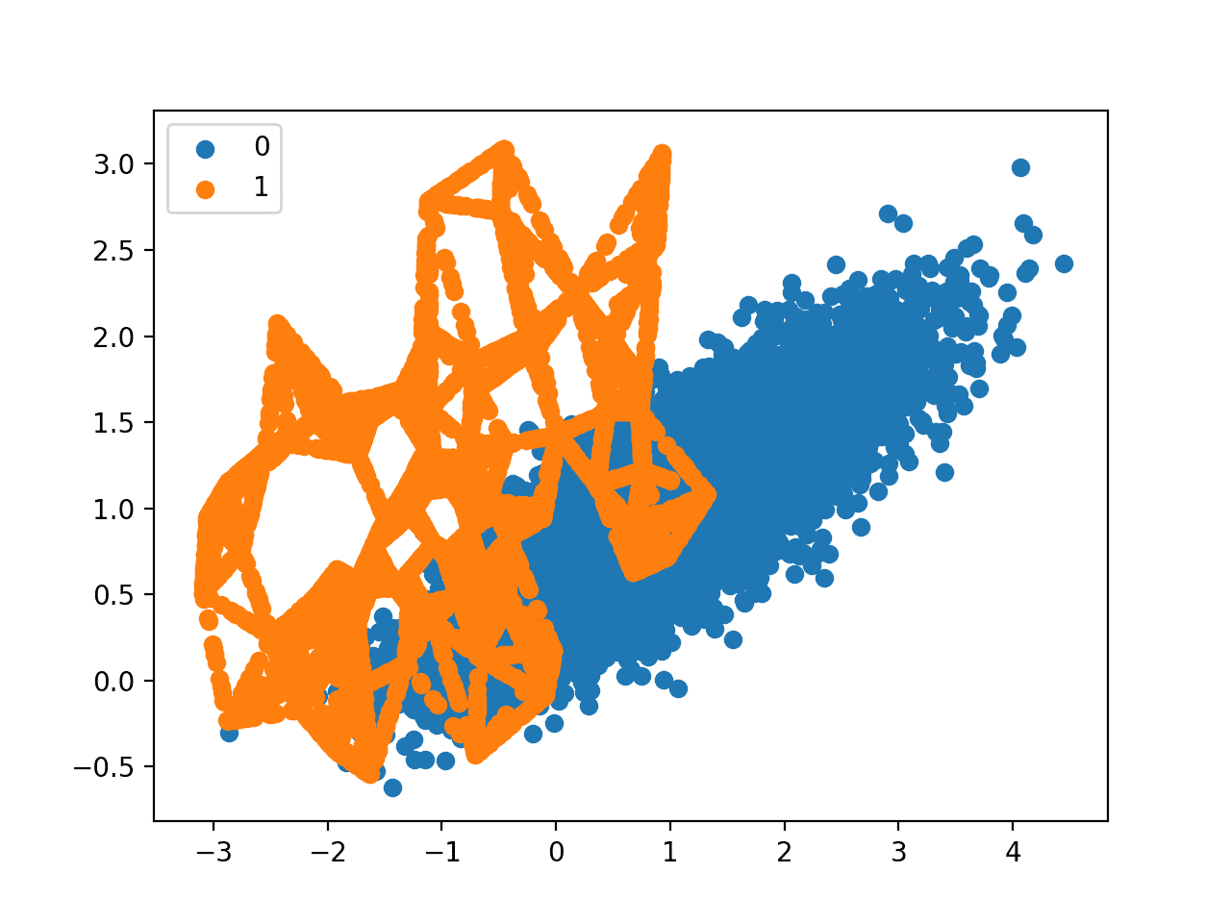
Applying SMOTE
Synthetic Minority Oversampling Technique
Instead of creating duplicate like up sampling, this method creates new datasets that are ‘neighbors’ to the old ones

Slide 18
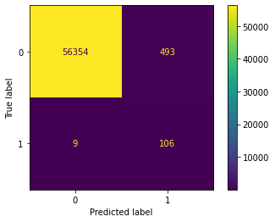
Applying SMOTE
Scoring Metrics:
Accuracy = 0.99119
Precision = 0.17696 (low!)
Recall = 0.92174 (improved!)
f1-score = 0.29692
Logistic Regression

Slide 19
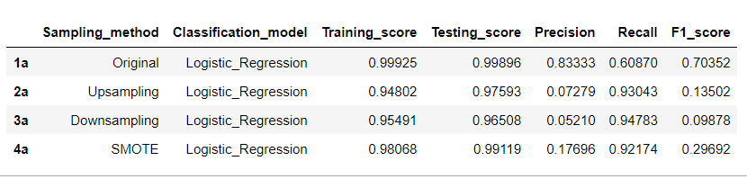
Comparing sampling method
Logistic Regression

Slide 20
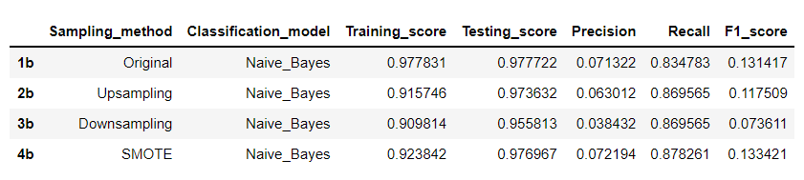
Comparing sampling method
Naïve Bayes

Slide 21
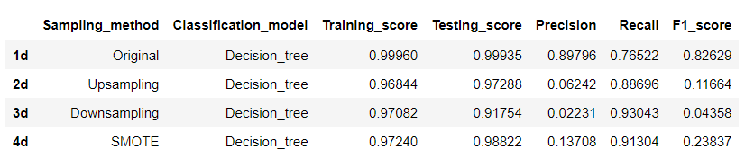
Comparing sampling method
Decision Tree

Slide 22
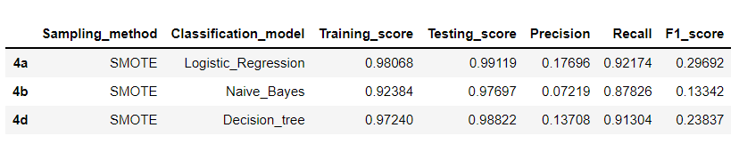
Comparing Classification Models
Logistic Regression has better precision and recall,
But this is before hyper-parameter tuning

Slide 23
Optimal Parameters
Logistic Regression: C :30, penalty : l1
Naïve Baye: var_smoothing : 1.0
Decision Tree: 'max_leaf_nodes': 99, 'min_samples_split': 2

Slide 24
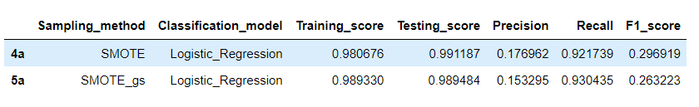
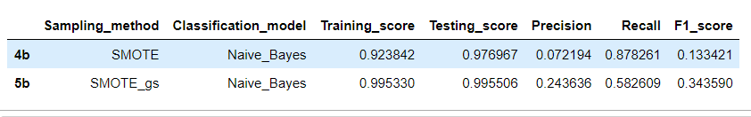
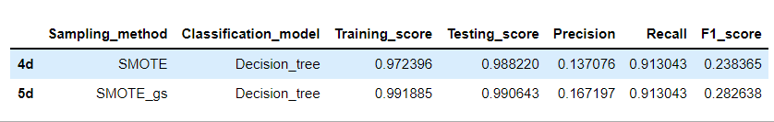

Slide 25
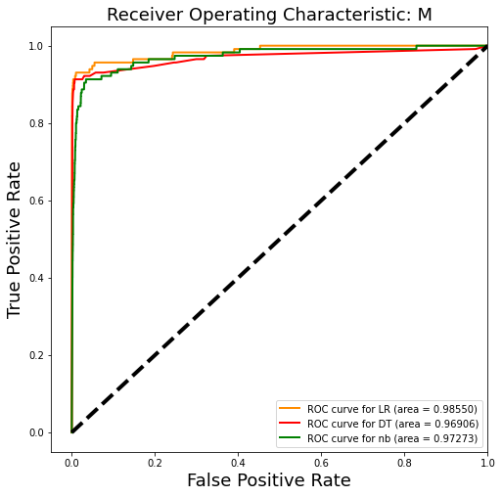
Logistic Regression
Best performance

Slide 26

Conclusion
Recommended Model: Logistic Regression
Provided a balance between recall and precision scores

Slide 27
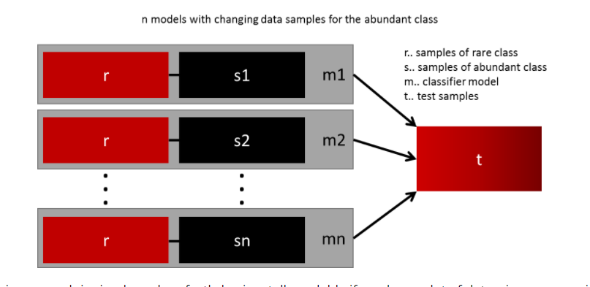
Future Work
Hyper parameter tuning with a different score function
Apply Ensemble Method
  Random Forest
  Ensemble different resampled datasets
Proceed to Deployment
https://www.kdnuggets.com/2017/06/7-techniques-handle-imbalanced-data.html

Slide 28
Thank you!

